Slide 1
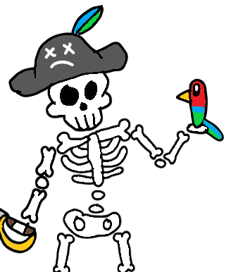
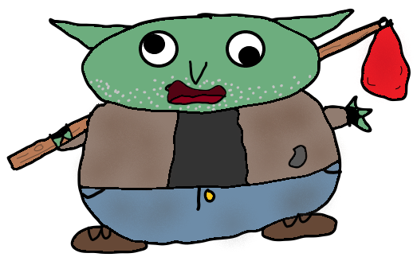
REALLY (kinda) B.A.D IDLE GAME
(Just Kidding) The Prequel II
B.A.D At Development:
Adrien Abbey, Muhammed Abushamma, Luke Davidson, Brandon Walker

Slide 2
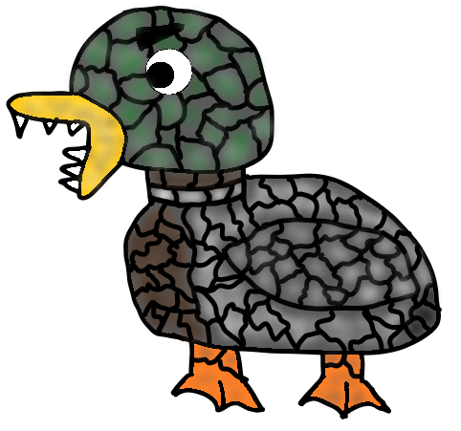
Elevator Pitch
B.A.D Idle Game is a new game that combines fantasy elements with hands off combat. Engage in Idle fights with various goofy monsters like the hobo goblin or rabid pet rock. You can start combat, do some tasks around the house, then come back and see what your brave fighter has endured. When not fighting you can visit the local tavern, talk to the locals, or harvest resources to purchase a homestead. Regardless of how you decide to play, we promise you will come back wanting more!

Slide 3
User Stories
Idle Combat
As a player I want to engage in Idle combat so that I can start combat, watch a movie, and come back to see how my character has progressed.
UI
As a player I want to have an easy to navigate UI so that I can easily know where to go and what buttons will do.
Supporting Systems
As a player I want to have additional features besides combat so that I can feel more engaged and have more fun.
Documentation
As a developer I want to have helpful documentation so that I can know how the codebase works and explain it to others.
Notes:
All of us. Everyone do their respective user story

Slide 4
System Architecture
Code is written in Java and utilizes the Swing library to create the GUI components such as buttons and labels and AWT for additional functionality like handling dimensions, events, and displaying graphics.
Development was done in Visual Studio Code. Github and Github desktop were used for version control.

Slide 5
Methodology
For this project we used an Agile-esque methodology.
Our main way of delegating work was through Github Milestones and Issues.
We would work in a cycle where once Github issues were assigned we would have “Individual sprints” where we would each work on our own branches.
Each member makes a new branch when they start on an assigned issue, and then when finished they submit it for merge with main, and it gets checked over and tested by at least 2 other members of the team.
Once these issues would be completed, we would have a stand up meeting and discuss where to move next and the cycle would repeat.

Slide 6
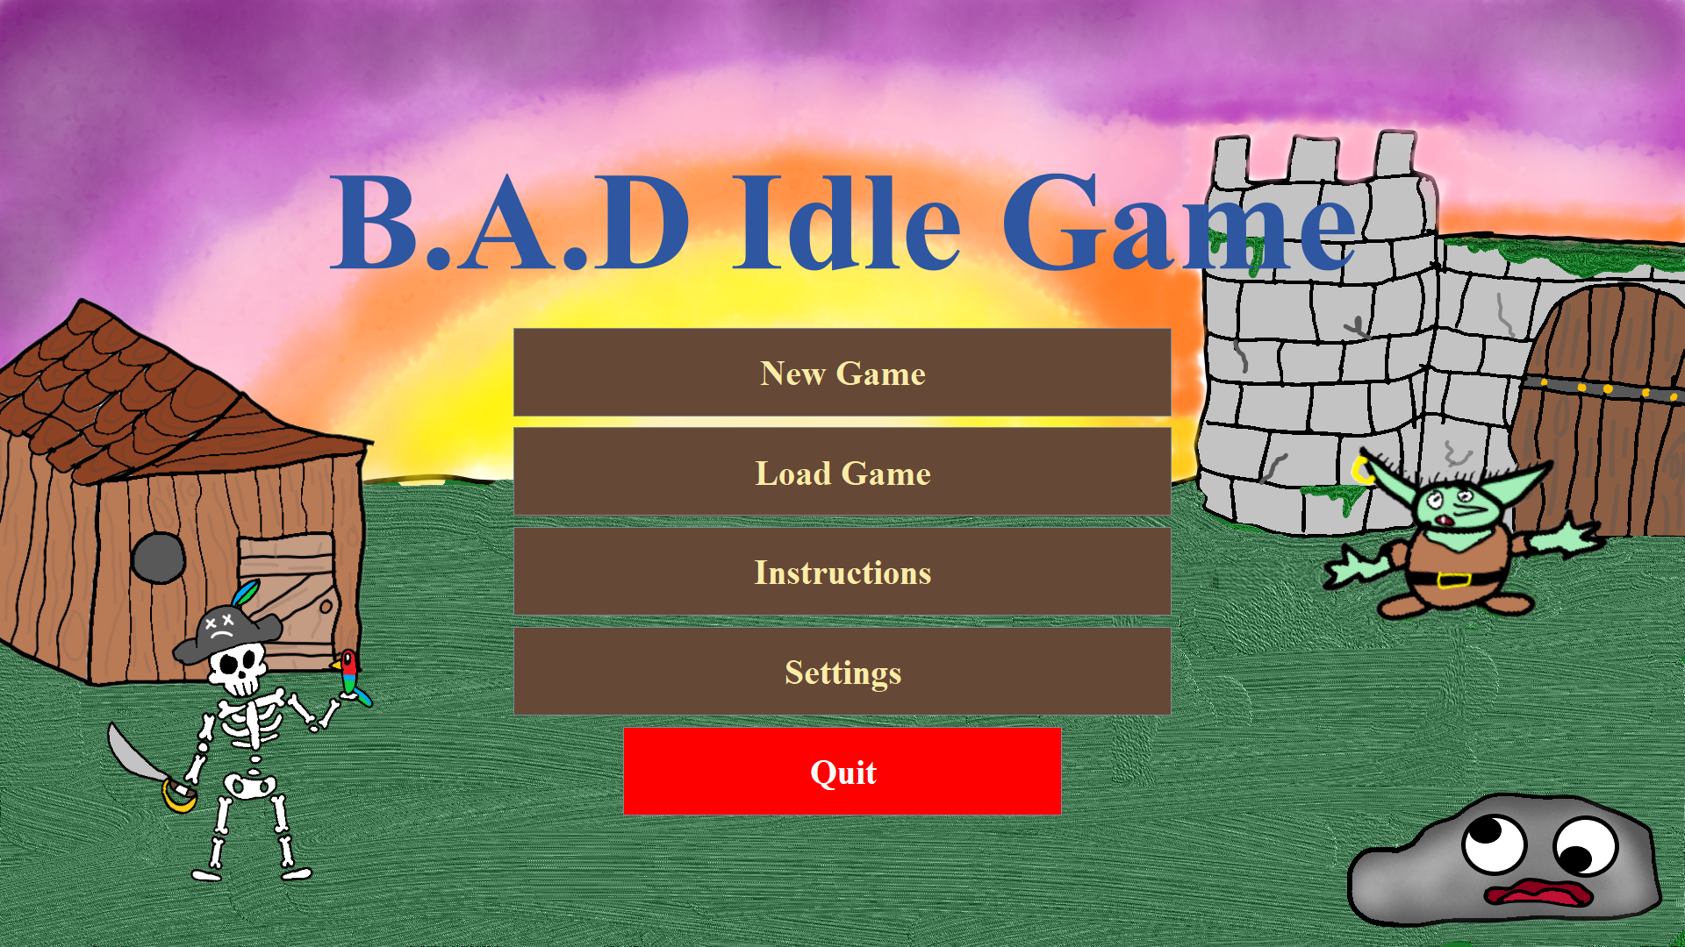
Requirements
1. The game shall be operated via a graphical interface and buttons that shall be on screen.
a. The whole interface shall be controlled from a central Driver to remove window swaps when changing screens and unify the screens.
b. The game shall have a start screen for creating a new game, loading a saved game, reading instructions, or exiting.
Notes:
Luke

Slide 7
Requirements (cont’d)
2. The user has a player character that has a name, three stats, equipment, potions, and gold.
a. The user shall be able to save and load their character.
b. A character shall consist of a name and the muscle, brain, and heart stats.
Notes:
Adrien

Slide 8
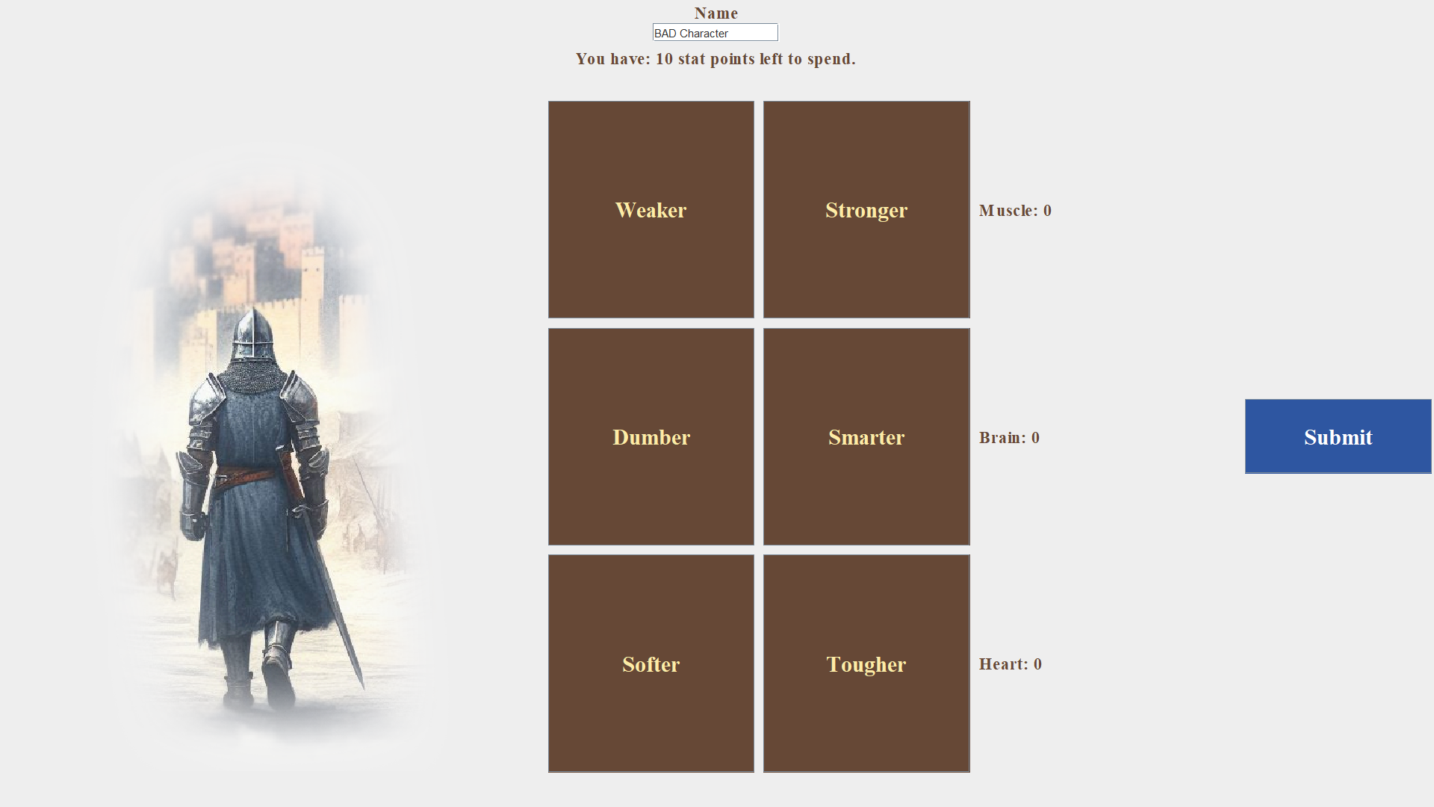

Slide 9
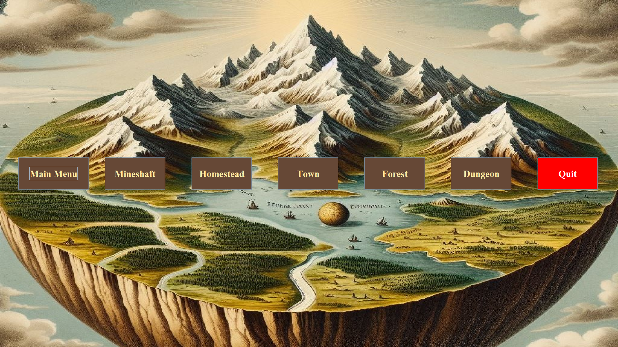
Requirements (cont’d)
3. The user shall start at a world map screen upon picking a character. This will serve as the primary way of navigating the game.
Notes:
Luke

Slide 10
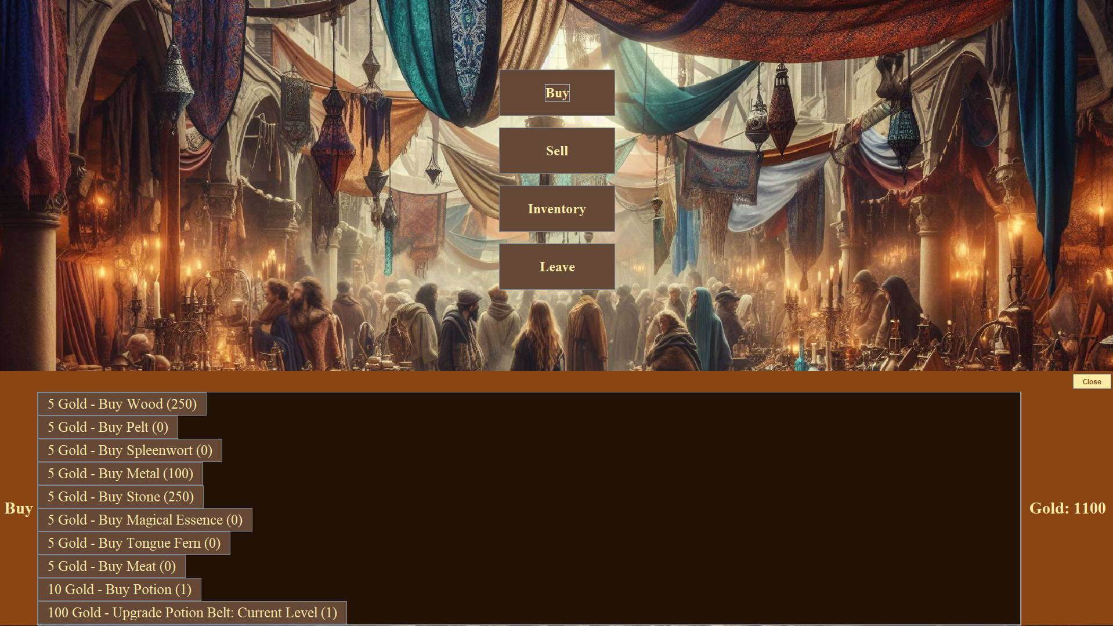
Requirements (cont’d)
4. The town shop will sell potions to heal the adventurer. The town is entered from the map screen.
1. The player's potion belt can be upgraded in size. This is the primary method of spending gold.
2. The player can buy potions to refill their belt.
Notes:
Muhammed

Slide 11
Requirements (cont’d)
5. The dungeon will be where the primary combat loop takes place. The dungeon is selected from the map screen.
a. Dungeons can only be entered when the player's health is above zero.
1. Each dungeon will have a list of monsters that can spawn in them.
b. The player will be able to toggle between offensive and healing magic with a button.
c. Combat hits and damage shall be affected by dice rolls.
1. The player and the enemy monster take turns attacking each other.
2. Physical attacks will be based off of strength statistic.
3. Magic attacks will be influenced by their brain statistic and their remaining mana points.
(continued below)
Notes:
Brandon

Slide 12
Requirements (cont’d)
(continued)
d. The player can click a button to use a potion from their belt to heal.
e. If the players HP hits 0, they can't continue combat until either a certain amount of time has elapsed or until healed with a potion.
f. If the monster hits 0 HP, the player is rewarded with gold and a chance at equipment upgrades.
1. After defeating a monster, a new monster replaces it.
g. The player can choose to withdraw from the dungeon at any time.
1. Withdrawing from a dungeon without dying will return the player to the map screen. They can return to the dungeon and continue at any time.
Notes:
Brandon

Slide 13
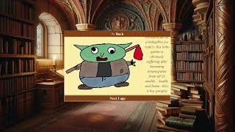
Requirements (cont’d)

Slide 14
Requirements (cont’d)
6. The player will have gear consisting of a weapon, armor and a hat.
1. This gear will be obtained by defeating enemies in the dungeon.
1. Each defeated enemy will upgrade a piece of equipment.
2. Equipment has levels, which increase the character’s stats.
1. Weapons upgrade muscle, armor upgrades heart, and hats upgrade brain.
Notes:
Adrien

Slide 15
Requirements (cont’d)
7. The player will be able gather resources from various different areas in the world.
1. Wood, stone, metal and various other resources will be stored in the player's inventory.
2. Mining ore in the mineshaft will allow the player to harvest stone or metal. Scavenging will allow the player to harvest magical essence, spleenwort, or tongue fern.
3. Cutting wood in the forest will allow the player to harvest wood. Hunting will allow the player to harvest pelt or meat.
4. Harvesting a resource will regenerate the player's health and magic stat by 10% of the maximum value of their health and magic stat. This will only occur if stats are below their maximum
Notes:
Muhammed

Slide 16
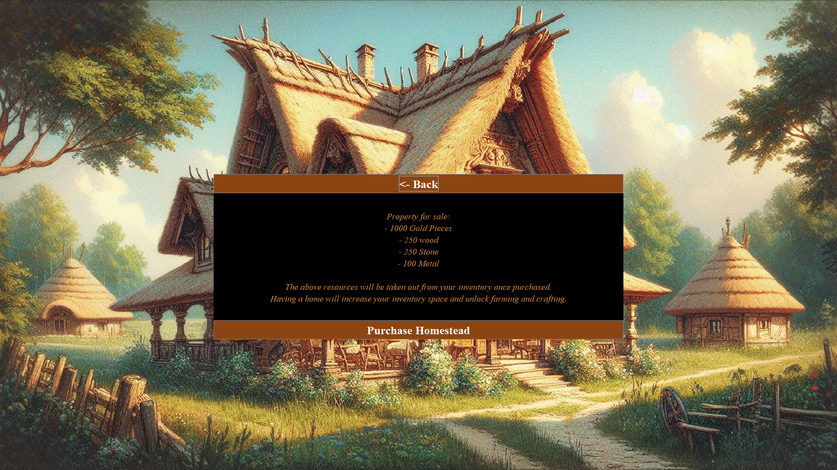
Requirements (cont’d)
8. The player will be able to buy a homestead. The homestead screen can be accessed from the world screen.
Notes:
Muhammed

Slide 17
Requirements (cont’d)
9. There will be tavern, library, and bazaar screens that can be accessed using the buttons located on the town screen menu.
1. The tavern will house allow for chatting with townsfolk. There will be various prompts for different NPCs.
1. Prompts iterate around a predetermined set whenever the player presses the "Talk to townsfolk" button. This will have a narration sound byte.
2. The bazaar screen will allow the player to buy and sell items from their inventory. It will also allow the player to look into their inventory.
3. The library screen will have the implementation for the "Book of Monsters". This will contain the descriptions and images for monsters in the game. They will also have a corresponding sound effect for each.
Notes:
Muhammed

Slide 18
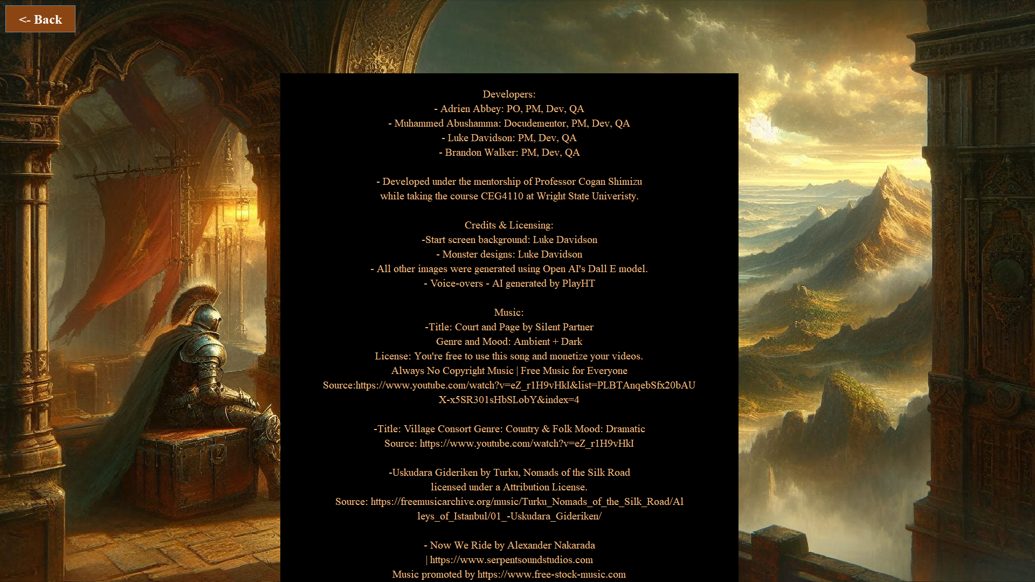
Requirements (cont’d)
10. There will be a rolling credits screen that can be accessed from the settings panel that will credit the developers, professor, art, images, music, and sound effects used.
Notes:
Muhammed

Slide 19
Requirements (cont’d)
11. Most if not all panels will have an accompanying background image and music.
Notes:
Muhammed

Slide 20

Requirements (cont’d)
12. Most if not all of the buttons and will have an accompanying sound effect.
Notes:
Muhammed

Slide 21
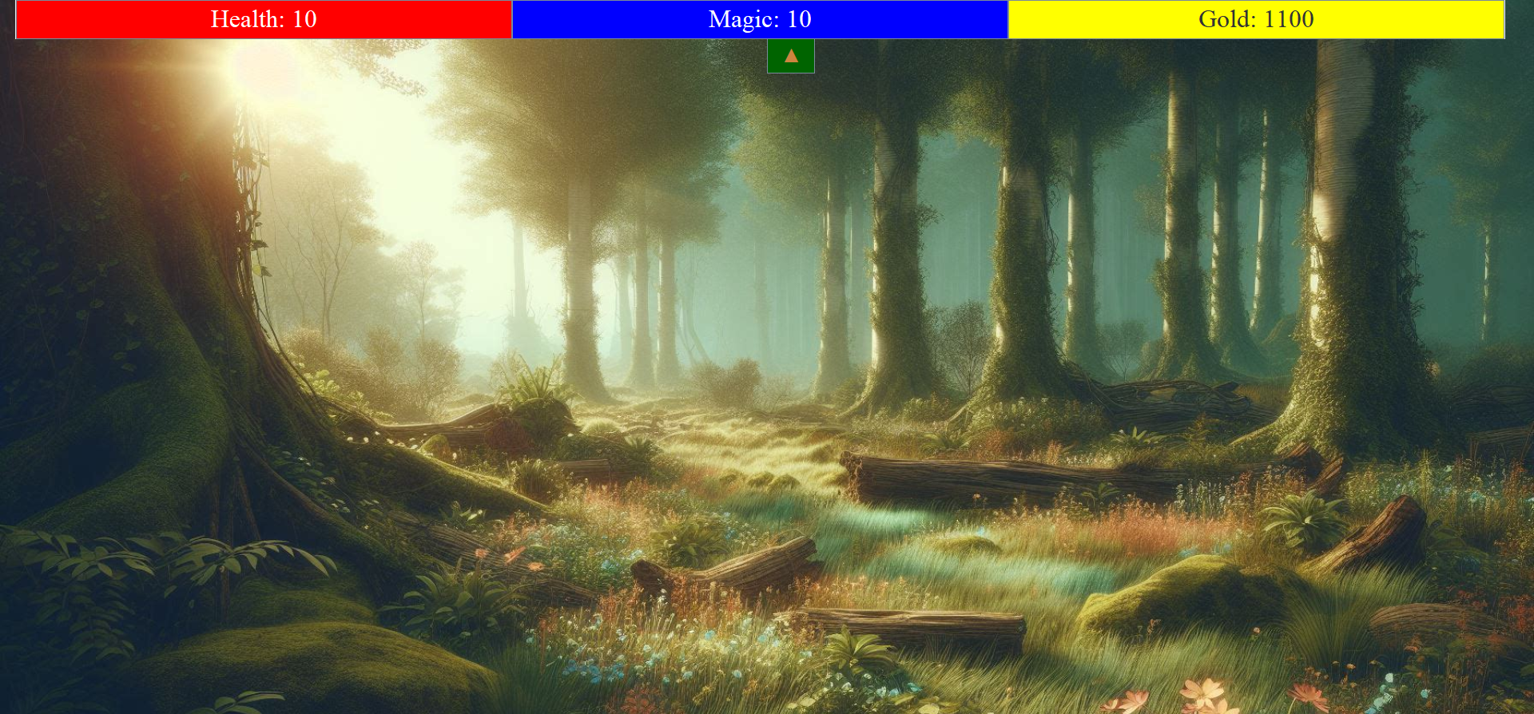
Requirements (cont’d)
13. There shall be a status bar button and panel present in the forest and mineshaft screens. This will show the values of health, magic, and gold the player currently has.
Notes:
Muhammed

Slide 22
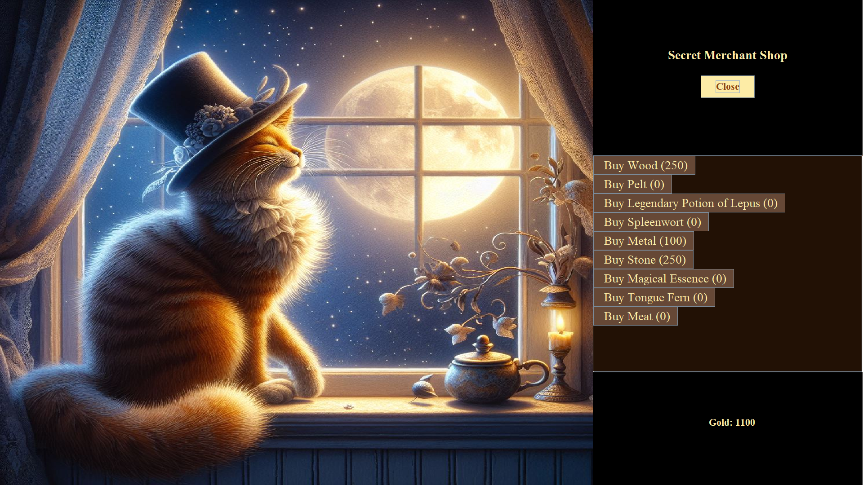
Requirements (cont’d)
14. There will be a secret merchant screen that can be accessed from the bazaar screen.
1. The button that takes the player to the secret merchant panel will appear every fourth bazaar visit. They sell a secret item.
Notes:
Muhammed

Slide 23
Final State of Project

Slide 24
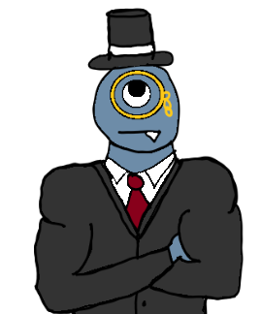
Things we learned
Team projects involve multiple people. People who don’t always think the same way. By this I mean ideas I thought we all agreed upon ended up being contentious. Like our theme regarding the human condition that never happened. - Adrien
This course gave me a deeper understanding of the software development process and a deeper insight into working on team-oriented, multi-month projects. - Muhammed
From this project I learned how to use Github more in depth, and especially how to navigate repos and branches with a team. - Luke
I learned how to more effectively work on a single code base with multiple developers, and how to navigate and make use of Github more effectively. - Brandon
Notes:
All of us

Slide 25
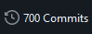
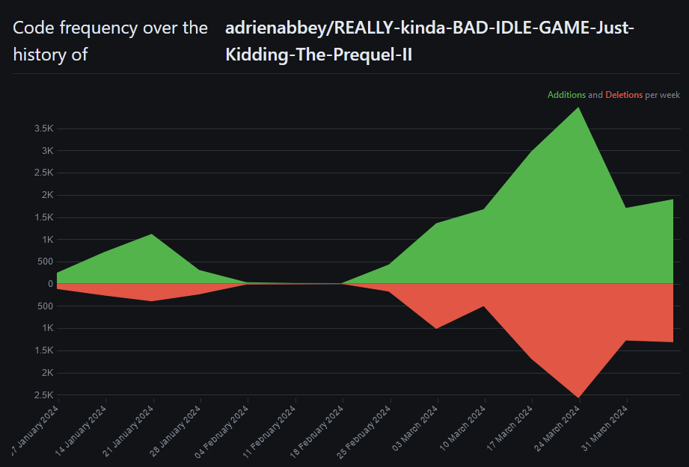
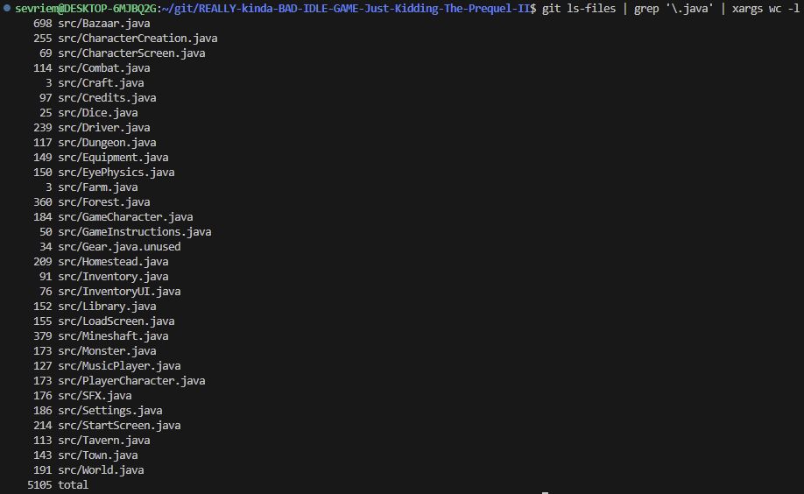
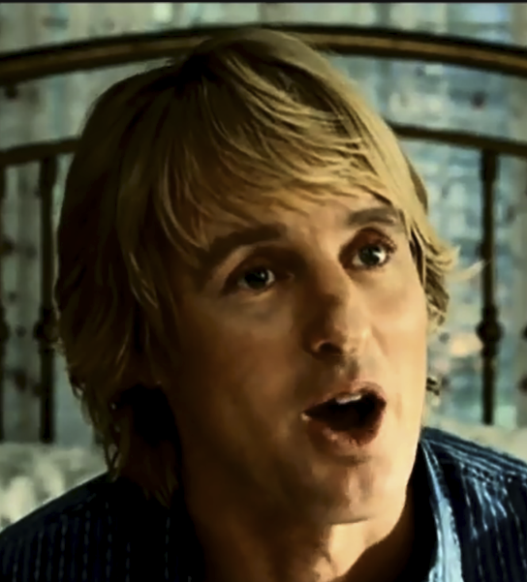
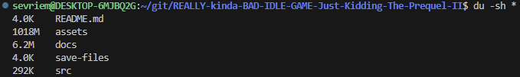
Cool Stats ¯\_(ツ)_/¯
Our code frequency over the entirety of our repository
Total line counts from each file in our repository.
Highest: 698 Lowest: 3
<- Over 1 GB of assets!!! WOW.

Slide 26
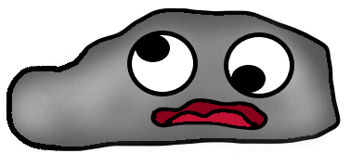
Thank you
Questions?
Notes:
All of us

